Slide 1
ENTERPRISE APPLICATIONS

Slide 2
ENTERPRISE APPLICATIONS
An Enterprise Application is the phrase used to describe applications (or software) that a business would use to assist the organization in solving enterprise problems.
When the word "enterprise" is combined with "application," it usually refers to a software platform that is too large and too complex for individual or small business use.
EA software is a critical component of any computer-based information system. EA software ultimately enhances efficiency and productivity through business level support functionality.

Slide 3
CHARACTERISTICS OF AN ENTERPRISE APPLICATION
Enterprise applications are inherently complex. Thus, it is imperative to understand the characteristics of a good enterprise application. These characteristics may vary based on the domain of the application.
The characteristics of a good enterprise application are:
1.Reliability and Availability
2. Security
3. Scalability

Slide 4
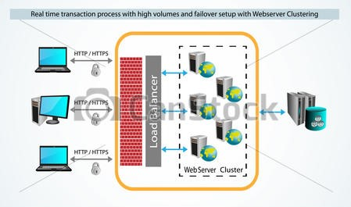
ENTERPRISE APPLICATION ARCHITECTURE
Vector illustration of Real time request process and Security. http or https Request coming through fire wall and load balancer, the request are handled by Web servers cluster in round robin

Slide 5
COMPONENTS AND LAYERS
COMPONENTS:
A centralized broker that handles security, access, and communication. This can be accomplished through integration servers or through similar software like the enterprise service bus (ESB) model that acts as a services manager.
A connector, or agent model where each vendor, application, or interface can build a single component that can speak natively to that application and communicate with the centralized broker.
A system model that defines the APIs, data flow and rules of engagement to the system such that components can be built to interface with it in a standardized way.

Slide 6
LAYERS:
Presentation Layer - Contains user related functionality for managing user interaction with the system, and generally consists of service calls for communicating with business logic through service layer.
Service Layer - Consists of service contracts and message types to communicate with the business logic to separate the business layer as an independent layer. Also this layer can be located on different tiers, or they may reside on the same tier.
Business Layer - This layer implements the core functionality of the system, and encapsulates the relevant business logic. It generally consists of components, some of which may expose service interfaces that other callers can use.
Data Access Layer - This layer communicate with database to retrieve and save the data in database using its own context. This data access layer exposes generic interfaces that the components in the business layer can consume.
Data Layer - This layer contains the actual business raw data. DBA can design and maintain this layer.

Slide 7
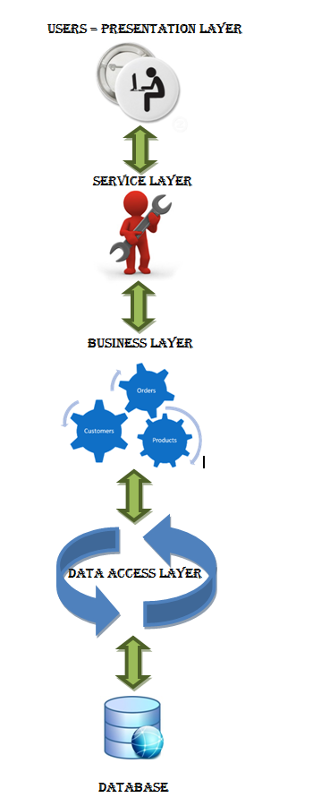

Slide 8
PATTERNS
Enterprise Applications are of Three types. They are:
1. Integration patterns
1.1 Mediation (intra-communication)
1.2 Federation (inter-communication)
2. Access patterns
3. Lifetime patterns

Slide 9
1. Integration patterns:
1.1 Mediation:
Here, the EAI system acts as the go-between or broker between multiple applications. Whenever an interesting event occurs in an application (for instance, new information is created or a new transaction completed).
1.2 Federation:
Here, the EAI system acts as the overarching facade across multiple applications. All event calls from the 'outside world' to any of the applications are front-ended by the EAI system.
Both patterns are often used concurrently. The same EAI system could be keeping multiple applications in sync (mediation), while servicing requests from external users against these applications (federation).

Slide 10
2. Access Patterns:
EAI supports both asynchronous and synchronous access patterns, the former being typical in the mediation case and the latter in the federation case.
3. Lifetime Patterns:
An integration operation could be short-lived (e.g. keeping data in sync across two applications could be completed within a second) or long-lived (e.g. interacting with a human work flow application for approval of a loan that takes hours or days to complete)

